Slide 1
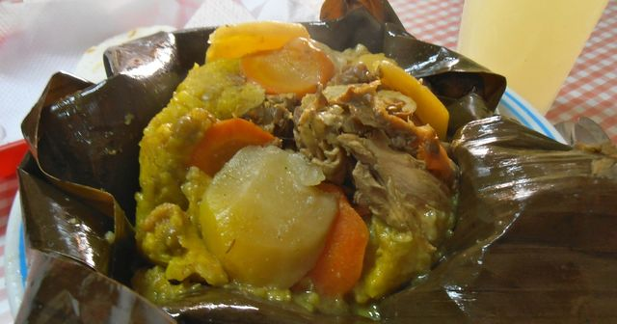
UNIDAD 3 ACTIVIDAD INTEGRADORA
TAMIL TOLIMENSE

Slide 2
LINK DEL BLOG ACTIVIDAD 3 UNIDAD 3
https://ingsstinlges.home.blog/2019/03/02/primera-entrada-del-blog/

Slide 3
TAMIL TOLIMENSE
INGREDIENTES:
1/2 Kg beaten White corn
1 chicken cut into médium pieces
Salt, cumin and pepper
1/2 kg bacon with leather
1/2 kg pork rib
1 Tied long chopped onion
3 Crushed garlic cloves Annie
1/4 kilo of cooked rice
1/4 kilo of dry and cooked peas Banana leaves soasadas
1/2 Kg peeled and chopped potatoes
1/4 kilo of carrots cut into slices
3 Cooked eggs cut in helmets Cabuya (penca with large, fleshy leaves)

Slide 4
Pasos 75 minutos
Keep the corn soaked for three days by changing the water every day.
Grind and marinate chicken with salt, cumin and pepper.
Parboil the bacon leather and the pork rib in six cups of water and a little salt for twenty minutes, reserve the broth.
Mix the ground corn with three cups of broth and strain.
Use the bacon fat to fry the onion, garlic and achiote for ten minutes.
Add cooked rice, peas (pea) and corn, stir well and let rest 60 minutes.
For each tamale grease a banana leaf, put a bed of dough and place a little chicken, bacon, pork rib, potato, carrot and egg.
Put another layer of dough on top, take the tips and edges of the leaves and tie them very well.
Put to cook in the broth and water to cover them for about two and a half hours with the pot covered, over medium heat.

Slide 5
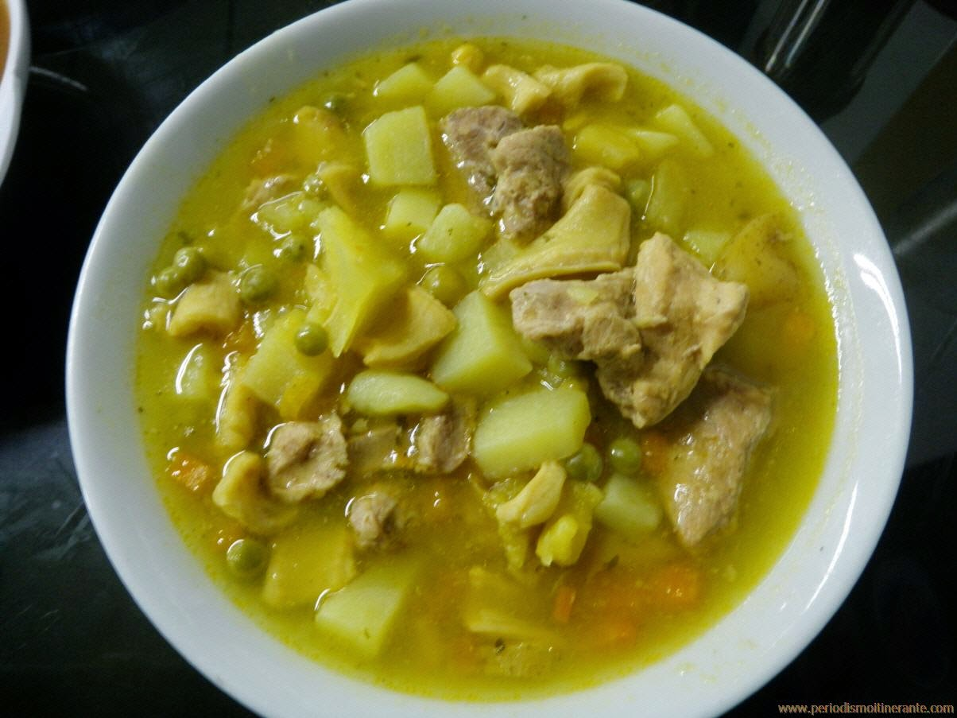

MONDONGO SOUP
Mondongo soup is made mainly by mondongo or also called callus, by a spine or leg of beef and other products that make this exquisite soup.
PREPARATION
Cook the tripe in a pressure cooker with enough water for one hour, until it softens and then boil the water. Chop the mondongo and the pork leg, join with the chorizos and smooth them in the hogao; let them sit for two hours. Bring water to boil; add cubes of chicken stock or another, onion of egg, garlic and saffron, cook for 20 minutes. Then add the mondongo, the pork leg and the chorizo. Let it cook over medium heat for 30 minutes until the vegetables soften and the broth achieves the desired texture. Finally add the chopped cilantro and serve hot. You can accompany it with a ripe banana and a few drops of lemon.

